Slide 1
Pre-Requirements for TAK Server Deployment

Slide 2
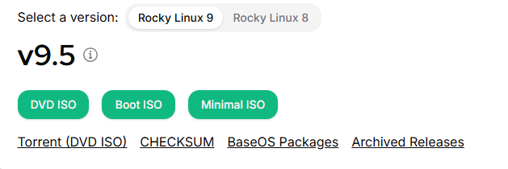

Downloading Necessary Files
Download Rocky Linux
Go to the following link and select Default Image Rocky Linux 9 Boost ISO, which should start a download
https://rockylinux.org/download
Download TAK-SERVER
Go to the following link and download Rocky release version of TAK Server on your local machine to the “TAK Server Install” folder
https://tak.gov/products/tak-server
Download Scripts
Go to the following link then to the TAK-SERVER folder and download the TAK SERVER SCRIPTS and the MASTER_SERVER_NAME_FOLDER_STRUCTURE onto your local machine and extract the zip files
http://maps.takserver.us/

Slide 3
Modify our Scripts – Opening the File
Unzip the “TAK SERVER SCRIPTS...”
Open “TAK SERVER SCRIPTS….” → open “Rocky#_Scripts”
In here we need to make sure the install script matches the TAK Server version we are using.
Notice that then name currently says “RL9.5_tak5.4r14_install.sh” or something similar to this, this indicates that an older version may be referenced currently.
To verify or update the current file being referenced we need to open the file.
Notes:
# Within here you can find six scripts, we know they are scripts since they will end in “.sh” or by looking at the “Type” within our file explorer window
# There is also a “Rocky8_Instructions” folder that contains instructions for the server and for enrolling a TAK Server client cert

Slide 4
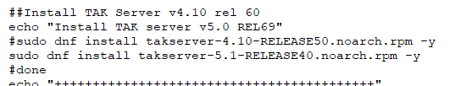


Modify our Script – Update the Script
To change this open the file “RL9.5_tak5.4r14_install.sh” with a text editor and scroll down to the following section.
Update the scripts to the downloaded TAK Server version.
Save the file and exit out of the text editor.

Slide 5
Set Up Your VM

